Slide 1
Lecture - 27 Opto Electronic Devices

Slide 2
Opto Electronic Devices
P-n junctions are an integral part of several optoelectronic devices. These include photodiodes, solar cells light emitting diodes (LEDs) and semiconductor lasers.
A large number of optoelectronic devices consist of a p-type and n-type region, just like a regular p-n diode.
The key difference is that there is an additional interaction between the electrons and holes in the semiconductor and light. This interaction is not restricted to optoelectronic devices.
Regular diodes are also known to be light sensitive and in some cases also emit light. The key difference is that optoelectronic devices such as photodiodes, solar cells, LEDs and laser diodes are specifically designed to optimize the light absorption and emission, resulting in a high conversion efficiency.

Slide 3
Light Emitting Diode (LED)
A light-emitting diode (LED) is a diode that gives off visible light when forward biased.
Light-emitting diodes made by using elements like gallium, phosphorus and arsenic. By varying the quantities of these elements, it is possible to produce light of different wavelengths with colours that include red, green, yellow and blue.
For example, when a LED is manufactured using gallium arsenide, it will produce a red light. If the LED is made with gallium phosphide, it will produce a green light.

Slide 4
Light Emitting Diode (LED)
When light-emitting diode (LED) is forward biased ,the electrons from the n-type material cross the pn junction and recombine with holes in the p-type material. Free electrons in the conduction band are at a higher energy level than the holes in the valence band.
When recombination takes place, the recombining electrons release energy in the form of heat and light. In germanium and silicon diodes, almost the entire energy is given up in the form of heat and emitted light is insignificant.
However, in materials like gallium arsenide, the number of photons of light energy is sufficient to produce quite intense visible light.

Slide 5
LED Voltage and Current
The current through the LED does not exceed the safe value, a resistor R_{S} is connected in series with it . The input voltage is V_{S} and the voltage across LED is V_{D}.

Slide 6
LED - Seven segment display
The light emitting region is available in lengths from 0.1 to 1 in. Numbers can be created by segments such as shown in Fig.
By applying a forward bias to the proper p-type material segment, any number from 0 to 9 can be displayed

Slide 7
LED - Seven segment display
There are also two-lead LED lamps that contain two LEDs, so that a reversal in biasing will change the color from green to red, or vice versa.
LEDs are presently available in red, green, yellow, orange, and white, and white with blue soon to be commercially available.
In general, LEDs operate at voltage levels from 1.7 to 3.3 V, which makes them completely compatible with solid-state circuits.
The power requirement is typically from 10 to 150 mW with a lifetime of 100,000_ hours.
Their semiconductor construction adds a significant ruggedness factor.

Slide 8
Problem
What value of series resistor is required to limit the current through a LED to
20 mA with a forward voltage drop of 1.6 V when connected to a 10V supply ?
R_{S} =0.42 K ohm

Slide 9
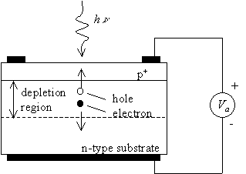
Photo diode
A photo-diode is a reverse-biased silicon or germanium pn junction in which reverse current increases when the junction is exposed to light.
The reverse current in a photo-diode is directly proportional to the intensity of light falling on its pn junction. This means that greater the intensity of light falling on the pn junction of photo-diode, the greater will be the reverse current.
The inward arrow represent the incoming light.

Slide 10
Photo diode
When light (photons) falls on the pn junction, the energy is imparted by the photons to the atoms in the junction. This will create more free electrons.These additional free electrons will increase the reverse current.
As the intensity of light incident on the pn junction increases, the reverse current also increases. In other words, as the incident light intensity increases, the resistance of the device (photo-diode) decreases.

Slide 11
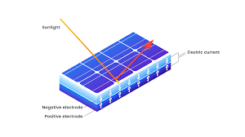
Solar cell
Solar cells are typically illuminated with sun light and are intended to convert the solar energy into electrical energy. A significant part of the solar spectrum is in the visible range of the spectrum (400 - 700 nm). The power density is approximately 100mW/ cm2.
Only part of solar spectrum actually reaches the earth’s surface. Scattering and absorption in the earth’s atmosphere and the incident angle affects the incident power density. Thus available power density depends on the time of the day, the season and the latitude of a specific location.

Slide 12
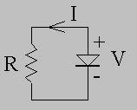
Solar Cell
Solar light which reaches a solar cell, only photon with energy larger than the energy band gap of the semi-conductor generate electron hole pairs.
The overall power conversion efficiency of a single crystalline solar cell ranges from 10 to 30% yielding 10-30 mW/cm2.
The circuit diagram and sign convention of a p-n diode solar cell connected to a resistive load is as shown in figure below.

Slide 13
Reference
Principles of Semiconductor Diodes, B. Van Zeghbroeck

Slide 14
Thank You

